Slide 1
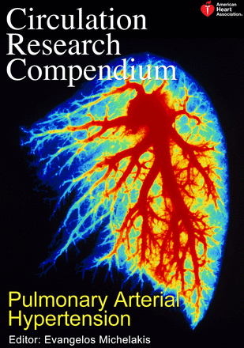
PAH-CLASSIFICATION AND PATHOPHYSIOLOGY
Dr Ajay Nair
Senior Resident
Calicut Medical College

Slide 2
Pulmonary Hypertension (PH)
mPAP > 25mm Hg at rest
Pulmonary arterial hypertension
mPAP > 25mm Hg at rest
+PCWP(or LVEDP) ≤ 15mmHg
+ PVR > 3Wood units (“new”)

Slide 3
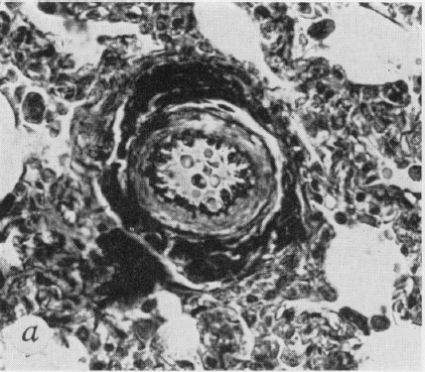
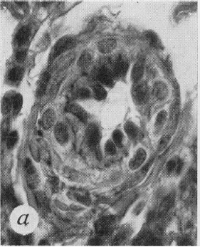
Heath-Edwards classification of pulmonary vascular changes in congenital heart disease (1958)
Grade I: Medial hypertrophy.
Grade II: Cellular intimal proliferation .
Grade III: Occlusive changes.

Slide 4
Heath-Edwards classification of pulmonary vascular changes
Grade IV: Dilation: Vessel is dilated, and media is abnormally thin.
Grade V: Plexiform lesion: There is cellular intimal proliferation, clustered around are numerous thin-walled vessels that terminate as capillaries in alveolar wall.
Grade VI: Acute necrotizing arteritis:
A severe reactive inflammatory exudate is seen through all layers of the vessel.

Slide 5
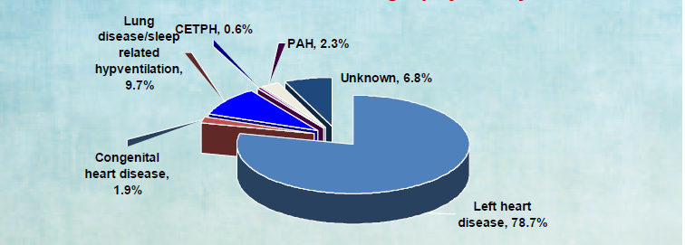

Slide 6
5th World Symposium on PAH – Nice, France 2013
4th- Dana Point, USA, 2008

Slide 7
Current Classification scheme is part clinical, part physiological and in part based on treatment implications.
Correct classification is important because of treatment implications

Slide 9
NICE VS DANA POINT
DANA POINT | NICE
No PVR Criterion | PVR > 3 WU Required (PAH Only)
No use of “borderline” PH | Unchanged
No exercise PH Criterion | Unchanged
PCWP Cutoff < / = 15 mm Hg | Unchanged
No Mention of fluid challenge | 500 ml fluid challenge to detect HFpEF
Vasoreactivity testing mentioned | Only for IPAH
No specific screening recommendation | Annual screening for SSc
Sickle cell associated PH in Group 1 | Group 5
Shistosomiasia associated PH in group 4 | Group 1

Slide 12
PULMONARY CIRCULATION ANATOMY
Unique – Due to double arterial blood supply
double venous drainage.
Pulmonary Arteries: 1)Elastic (>500µm)
2)Muscular(<500µm)
3)Arterioles

Slide 13
HEMODYNAMICS
Pulmonary circulation: High Flow
Low Pressure
Low Resistance
Normal mPAP at rest: 14.0 +/- 3.3
Independent of sex
Slight influence of age

Slide 15
Mean PAP in patients with different causes of pulmonary hypertension (PH)

Slide 16
GROUP 1 PH: PAH
Prevalance: 15-50/million

Slide 17
Heritable Pulmonary Arterial Hypertension
Reported in approximately 6% to 10% of patients with PAH.
Mutations in 3 receptors of the TGF-ß family identified in heritable PAH
Bone morphogenetic protein receptor 2 (BMPR 2)
Activin receptor-like kinase type 1, and
Endoglin
50% to 90% of mutations in BMPR2.
Latest additions to the list are: Cav1 and KCNK3 (TGF-β independent)

Slide 19
PATHOBIOLOGY
Pulmonary Vasoconstriction:
Early Component
Voltage-dependent and calcium-dependent potassium channels (PASMCs) modulate pulmonary vascular tone → Abnormal in PAH
Abnormal endothelial dysfunction
Pulmonary Vascular Proliferation:
Increased cellular proliferation
Decreased apoptosis

Slide 20
Extracellular Matrix Remodeling
Inflammation:
Inflammatory cell infiltration noted in arterial walls
IL-1,IL-2,IL-6,IL-8,IL-10,IL-12,TNF-α
*IL-6 receptor antibody tocilizumab reduced the severity of PH in pts with Castleman disease.

Slide 21
Pulmonary veins are classically unaffected in PAH but are affected in pulmonary veno-occlusive disease.

Slide 22
RV PATHOLOGICAL CHANGES
RV Metabolic Derangements:
Shift from oxidative to anaerobic metabolism is noted
Increased fatty acid oxidation
Glutaminolysis is noted
RV Ischemia:
Perfusion from RCA occurs only in diastole in PH.
Impaired angiogenesis (SSc)

Slide 23
RV calcium mishandling
Sarcomere Remodeling: Increased β Myosin
Decreased α Myosin
Changes in actin isoforms

Slide 24
DRUG AND TOXIN INDUCED PAH
Definite association: An association is demonstrated by an epidemic or a large multicenter epidemiologic study.
Likely association: Defined as a single case-control study demonstrating an association or a multiple-case series.
Possible association: Drugs with similar mechanisms of action as those in the definite or likely category but have not yet been studied.
Unlikely association: Drug has been studied in epidemiologic studies and an association with PAH has not been demonstrated.

Slide 25
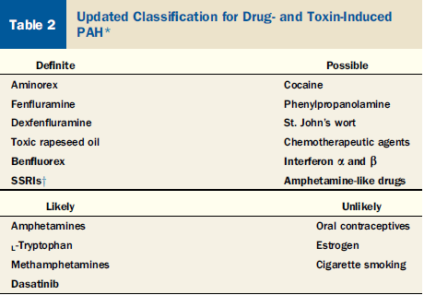

Slide 26
PAH Assoc. with connective issue disorders.
SSc- 8% to 12%.Routine screening adviced.
Reduced DLCO precedes Echo changes.
PAH Assoc. with HIV
0.5%
Independent of CD4
HAART has not changed prevalence
Unknown mech. Routine screening not recommended

Slide 27
PAH assoc. with Portal Hyperension.
a.k.a Porto Pulmonary Hypertension.
Portal Hypertension and not the underlying CLD is the risk factor.
Severity of CLD or severity of Portal Hypertension do not predict PPHT.
mPAP > 35mmHg is a contraindication for Liver Transplant

Slide 28
PAH Assoc with CHD

Slide 30
Survival of patients with ES is better than those with IPAH because:
RV adaptive response occurs
Sustain increased afterload better
Estimated 48% of patients with large unrepaired VSD develop ES.
ASD has a 7% risk.
All VSDs together have a 11% risk CONCOR REGISTRY
AVSDs 41% risk
Pressure rather than flow is more important for development of ES.
Endothelin-1 production is increased in patients with PH increased PVR and ES.

Slide 31
Pre tricuspid ES has worse outcome than post tricuspid ES.
PAH associated with Schistostomiasis
One of the most common causes of PAH world wide.
South America and sub-Saharan Africa hotbeds.
Seen in 5% pts with Hepato-Splenic disease

Slide 32
GROUP 1’’: PVOD & Pulm. Capillary Hemangiomatosis
A microvasculopathy
Occurs predominantly in young adults
PAH histology + Findings of Pulm. Venous HTN, Interstitial edema and lymphatic dilation.
Risk factors and clinical picture similar to PAH
Have lower SpO2 and DLCO at rest
Rapid development of pulmonary edema on administering PAH specific Tx is sometimes the first clue.
Can be familial – EIF2AK4 mutation

Slide 33
Group 2 PH: Caused by Left Heart Disease
Most common cause
Elevated Left sided filling pressures and PAWP
Trans pulm. Gradient- Normal (<12mm hg)
PVR is near normal (<3 Wood units)

Slide 35
Pathophysiology
Increase in LA pressure
Backward transmission of the pressure to PV/PC
Initially, PVR & pressure gradient across the lungs falls
(reflecting distention of compliant small vessels, recruitment of additional vascular channels, or both)
Further increases in LA pressure
↑ PAP & PVP, constant PBF, PG between PA & PV and PVR remains constant
When PVP ≥25 mmHg chronically
Abnormal formation and thickening of a neointima, medial hypertrophy,
thickening and rupture of the basement membranes , Pulmonary hemosiderosis
extensive fibrosis, Pulmonary lymphatics may become markedly distended
↑PVR
Disproportionate elevation in PAP, PG between PA & PV ↑, PBF ~ or ↓

Slide 36
Group 3 PH: Caused by Chronic respiratory diseases
Still unclear whether PH is the cause of worse outcome or just a marker of advanced disease.
Alveolar Hypoxia →Pulmonary Vasoconstriction and Remodeling →P.H
Progression slow
mPAP remains stable over long periods
Severe PH (Defined as mPAP > 40mmHg) rare

Slide 37
Pulmonary Hypertension Associated with Chronic Obstructive Pulmonary Disease
Exact prevalence is uncertain, heavily influenced by disease severity.(~ 50% in severe COPD)
mPAP is usually <30 mm Hg (typically lower IPAH)
RV failure occurs more likely as a result of an ischemic right ventricle than a pressure-loaded right ventricle.
Patients who present with severe pulmonary hypertension (mPAP >40 mmHg) should
be evaluated for another disease process responsible for the high pulmonary arterial pressures before it is attributed to the COPD (prevalence ~ 1.1 %)
1. Circulation. 2009;119:2250-2294

Slide 38
PATHOGENESIS
Multiple causative factors, including
alveolar hypoxia induced pulmonary vasoconstriction
Acidemia & hypercarbia
compression of pulmonary vessels by high lung volume
loss of small vessels in regions of the emphysema and lung destruction
↑blood viscosity (polycythemia).
Of these, hypoxia is the most important
factor.
Recently a genetic predisposition as a result of 5-HTT polymorphism, may predispose to more severe PH in
hypoxemic patients with COPD ¹.
1. Circulation. 2003;108:1839–44

Slide 39
Pulmonary Hypertension Associated with Interstitial Lung Diseases
Prevalence uncertain, ~ 40% in IPF & 60% planned for LTx¹
Mechanism
hypoxemia
loss of effective pulmonary vasculature from lung destruction
The hemodynamic profile is distinct from IPAH.
It is uncommon for the mean PA pressure ever to exceed 40 mm Hg in these patients, whereas it is unusual for the mean PA pressure to be less than 40 mm Hg in patients with IPAH.
1. Am J Respir Crit Care Med. 2003;167:735–40

Slide 40
Pulmonary Hypertension Associated with Sleep Disordered Breathing (SDB)
Prevalence: 20% to 40% of patients with SDB.
Mild to moderate in severity.
Mechanism: combination of precapillary and postcapillary factors.
primary mechanism is repetitive nocturnal arterial oxygen desaturation, which reflexively increases PA pressures.
others are
pulmonary arteriolar remodeling
hyperreactivity to hypoxia
left ventricular diastolic dysfunction
RV failure in SDB appears to be uncommon.

Slide 41
Group 4: CTEPH
Surgically curable PH
Described after at least 3 months of effective anticoagulation
Patient should have Pre-capillary PH with at least one segmental perfusion defect( Lung Scan, CT PA or Pulm.Angio)
Cumulative incidence of CTEPH after an episode of PE is .1% to 9.1%. (Braunwald)

Slide 42
Cumulative incidence of CTEPH after acute PE (NEJM 2004;350)
1.0% at 6 months,
3.1% after 1 year
3.8% after 2 years
Hypercoagulable state: in only a minority of patients
lupus anticoagulant ~ 10% to 20%
protein C, protein S, and antithrombin III deficiencies: ~ 5%
1. N Engl J Med. 2004;350:2257– 64

Slide 43
A clinical h/o Acute P.E – In 75% of pts.
Non Plasmatic risk factors include:
Splenectomy
Ventriculo Atrial shunt for Hydrecephalous
Inflmm. Bowel Disease

Slide 44
PATHOGENESIS
Pulmonary embolism (either single or recurrent)
Thromboemboli fail to resolve adequately
Undergo organization and incomplete recanalization
Incorporated into the vascular wall
(subsegmental, segmental, and lobar vessels)
Slowly progressive vascular obstruction including distal
pulmonary vasculopathy of both occluded and nonoccluded
pulmonary vasculature characterized by lesions considered
typical for IPAH, including plexiform lesions.
CTEPH

Slide 45
Infection, Immune Phenomena and Inflmmation contribute to vascular remodeling in addition to mechanical obstruction .
Based on surgery specimen 4 anatomic types of CTEPH are distinguished:
Type 1 Disease: 25% cases. Involves main and lobar PA with fresh red thrombus superimposed on white thrombus
Type 2 : 40% cases. Intimal thickening and fibrosis proximal to segmental arteries
Type 3: 30% cases. Fibrosis, intimal webbing and thickening confined to distal segmental and sub segmental arteries.

Slide 46
Type 4: <5%. Defined by microscopic distal ateriolar vasculopathy without visible thrombus.
Type 4 is inoperable

Slide 47
GROUP 5 PH
Group 5.1 : Hematological Disorders
Chronic Myeloproliferative disorders
Multifactorial etiology:
CTEPH
Vascular Remodeling
PVOD
Tumor Microembolism
Drug Induced

Slide 48
Post Splenectomy
Due to thrombotic and thromboembolic complications
Splenectomy→ Thrombocytosis
Hypercoagulable State
Abnormal circulating RBCs
10% incidence as per one small study
Asso. With CTEPH and IPAH

Slide 49
Chronic Hemolytic Anemia: Sickle Cell Disease
Recently moved from group 1 to 5
Mixed etiology
PH prevalence in SCD - 6 to 10.5%
Both Precapillary PH and Pulmonary venous HTN secondary to LV Dysfunction seen.
Plasma free Hb→ Decreased Nitric Oxide bioavailability

Slide 50
Sarcoid associated PH
Incidence of PH- 5% to 28%
Mechanisms:
Extrinsic compression of pulm. Vessels
Intrinsic Vasculopathy
PVOD
Portopulmonary HTN
LV Dysfn

Slide 51
CRF associated PH
Multifactorial etiology:
Pulm. Venous HTN secondary to LV Dysfn
Hypervolemia
High output seco
Endothelial Dysfn
Vascular Calcification

